Slide 1
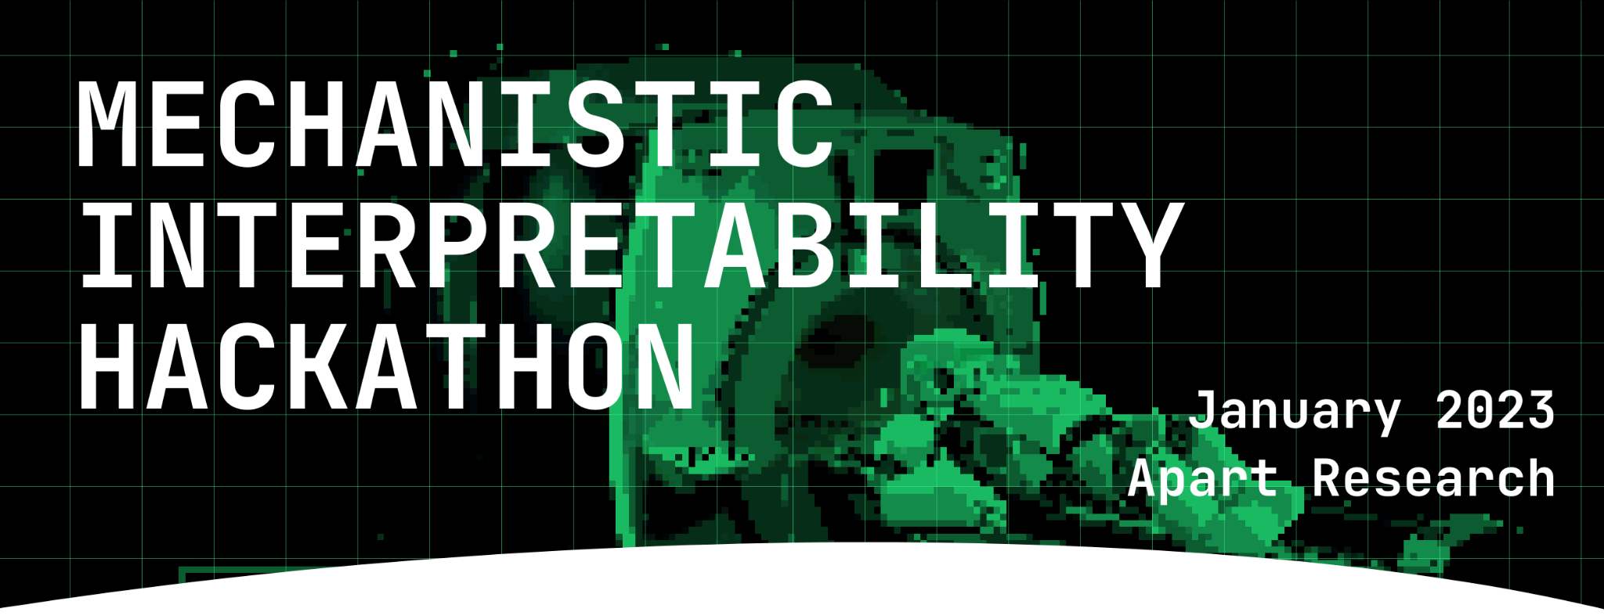
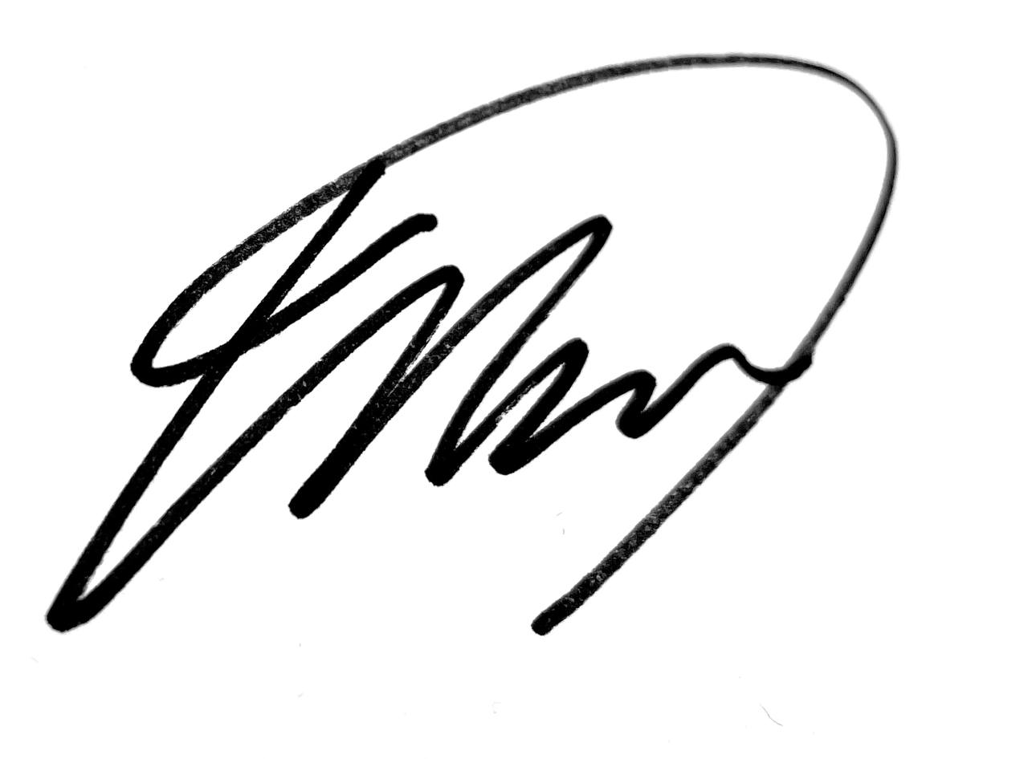
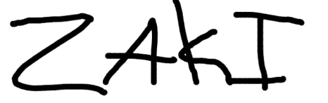
The Mechanistic Interpretability Hackathon
Certificate of Research Participation
November 2022
Awarded to
For
developing novel research inquiries during a 48 hour hackathon on reverse engineering neural networks.
Al-Hitawi Mohammed
Esben Kran
Director
Apart Research
Sabrina Zaki
Site manager
Apart Research

